Slide 1
AdiShila
आदिशिला
THE PRIMORDIAL STONE
Wholesale Product Catalogue 2026
Sacred Shungite Artifacts from Karelia, Russia
Crafted for the Indian Spiritual & Wellness Market

Slide 2
WHY SHUNGITE?
The Only Natural Fullerene C60 Mineral on Earth
2 Billion
C60
Only
EMF
Years Old
Fullerene
Deposit
Absorption
Formed during the Precambrian era
Nobel Prize molecule (1996)
Karelia, Russia — nowhere else
Documented radiation shielding
AdiShila is the first brand to bring authentic Karelian shungite to the Indian market — adapted for Vedic, Vastu, and Ayurvedic traditions.

Slide 3
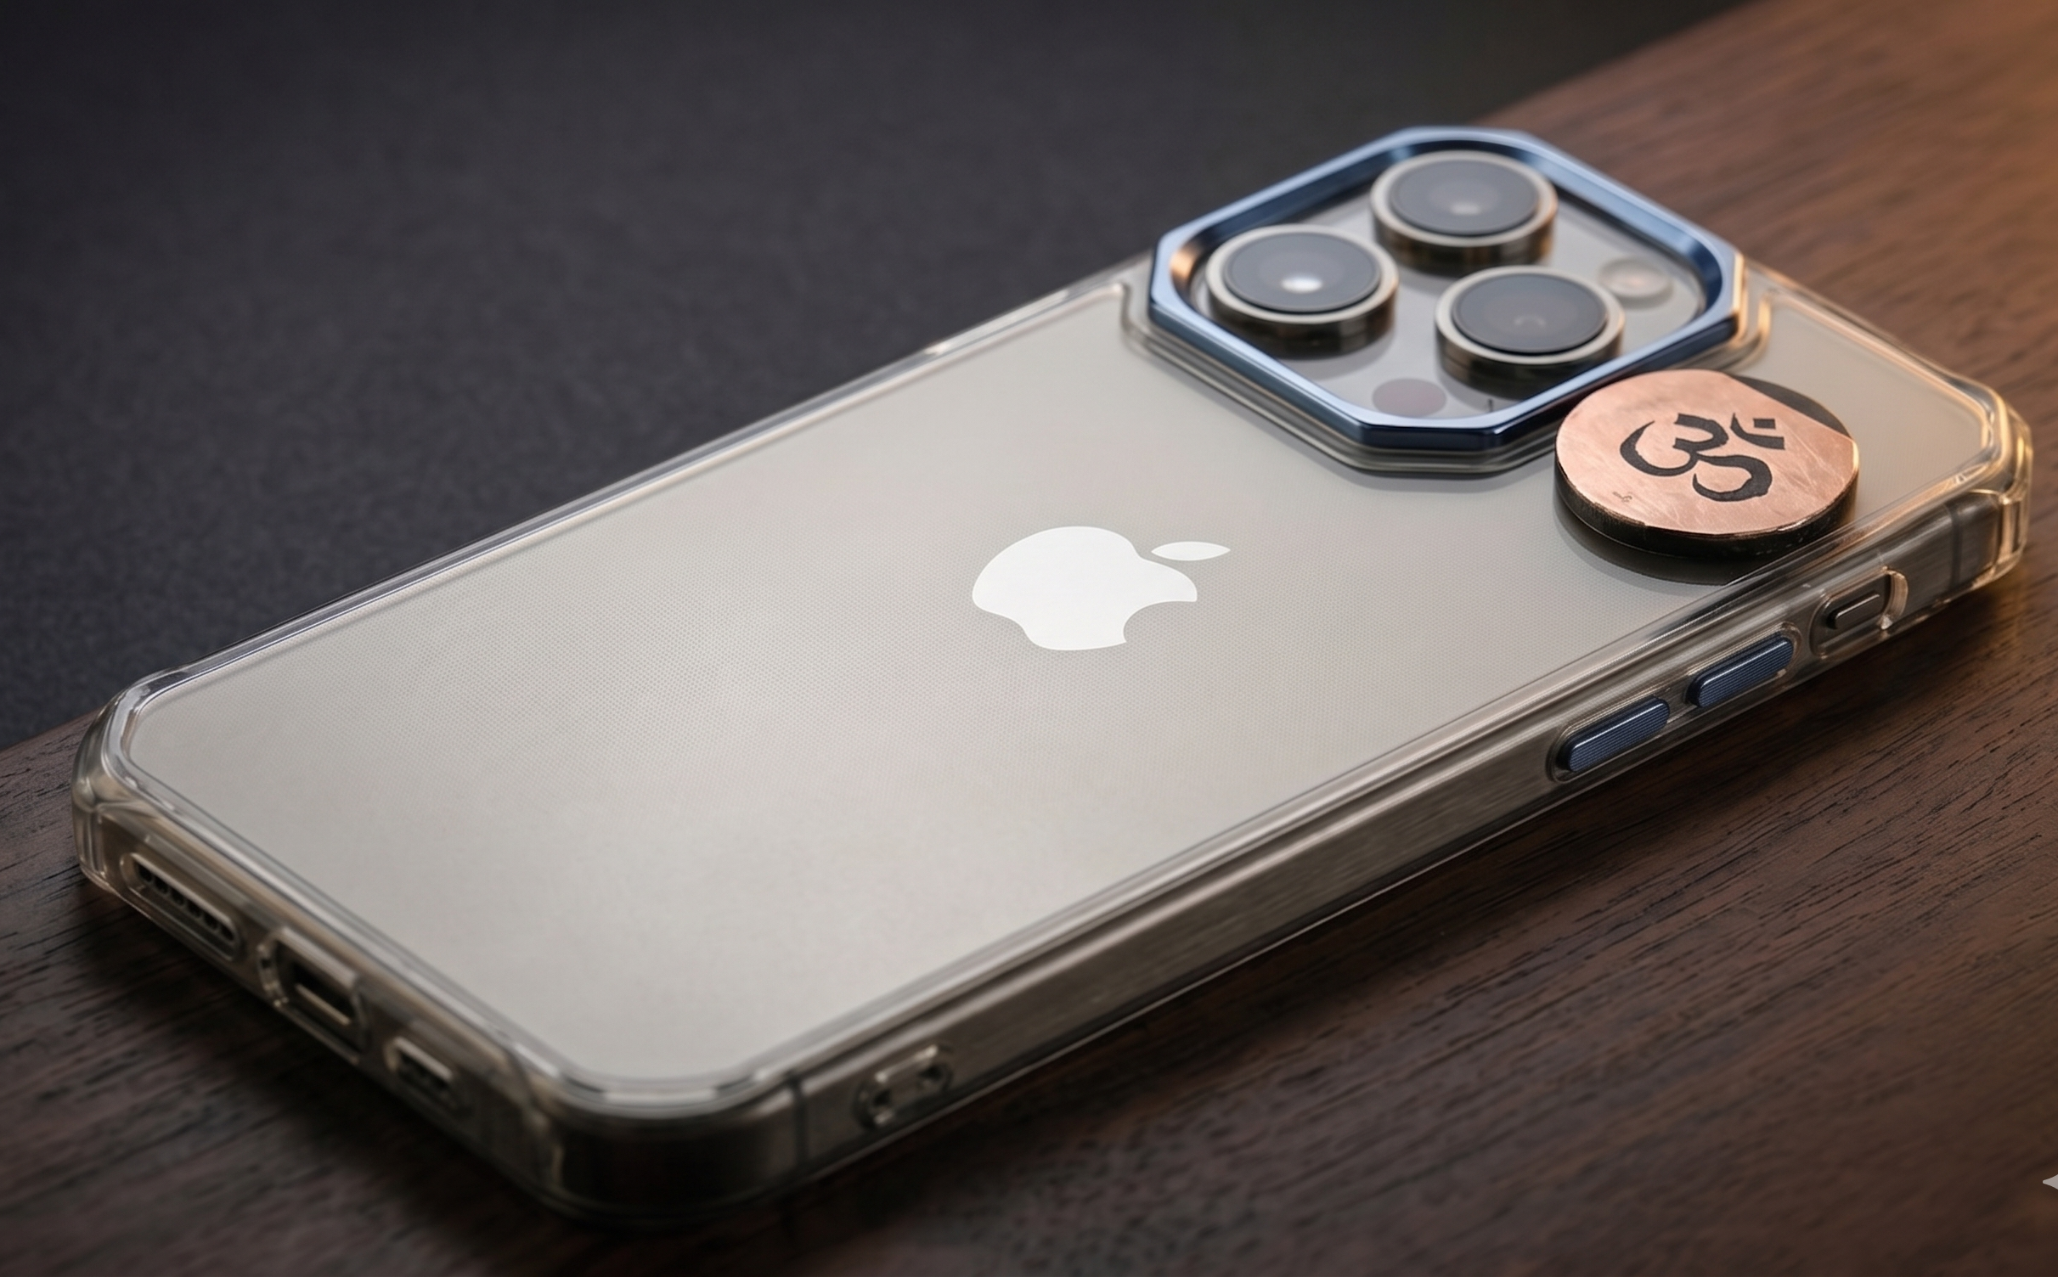
PRODUCT 01 OF 05
Kavach Shield — OM
EMF PROTECTION
कवच शील्ड — ॐ
Polished shungite plate in the sacred OM shape. Laser-engraved lines filled with gold paint. Adheres to any phone case via 3M VHB tape. Dual positioning: EMF radiation absorption + sacred symbol of protection.
SPECIFICATIONS
Dimensions
25 mm
Thickness
2.5 – 3.0 mm
Weight
4 – 6 grams
Adhesive
3M VHB removable
"Carry the sacred vibration of OM on the device you use most."
WHOLESALE
SUGGESTED MRP
RETAILER MARGIN
₹800 (25+ pcs)
₹1,499
46.6%

Slide 4
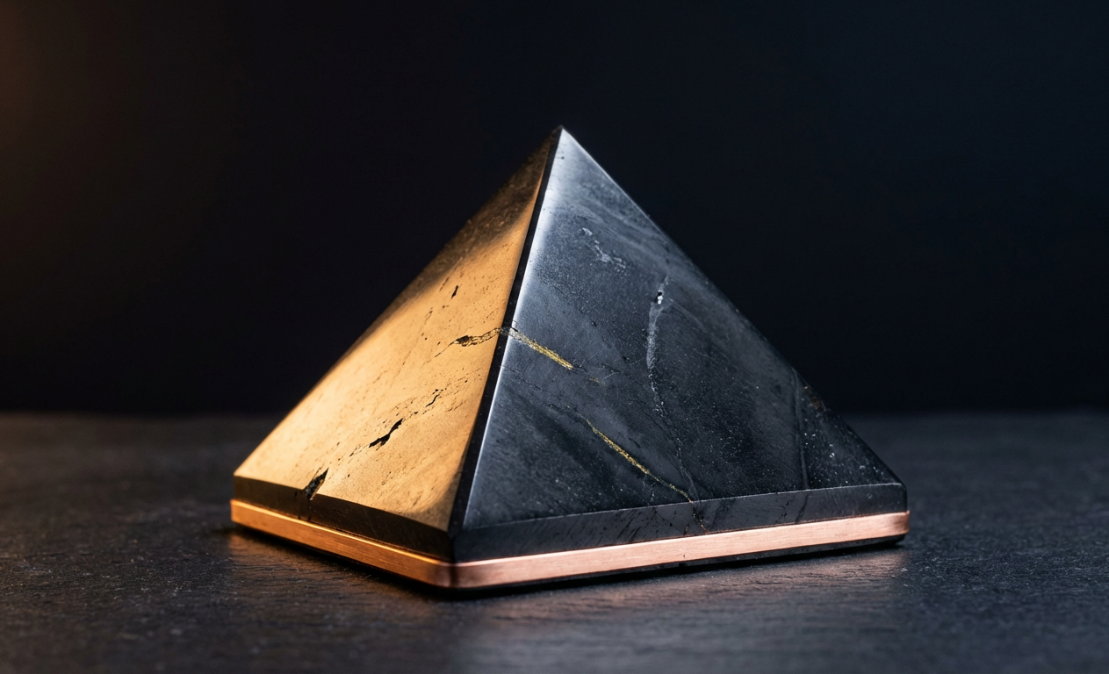
PRODUCT 02 OF 05
Vastu Dosh Pyramid
VASTU SHASTRA
वास्तु दोष पिरामिड
Polished shungite pyramid with copper foil band around the base. Black shungite absorbs negative energy; copper band conducts Prana per Vedic tradition. For room corners, routers, and office desks.
SPECIFICATIONS
Base
40 – 50 mm
Height
30 – 40 mm
Weight
60 – 120 grams
Copper Band
2–3 mm foil tape
"Pyramid geometry meets Earth's oldest mineral. Copper-activated for Vastu correction."
WHOLESALE
SUGGESTED MRP
RETAILER MARGIN
₹1,100 (25+ pcs)
₹2,199
50.0%

Slide 5
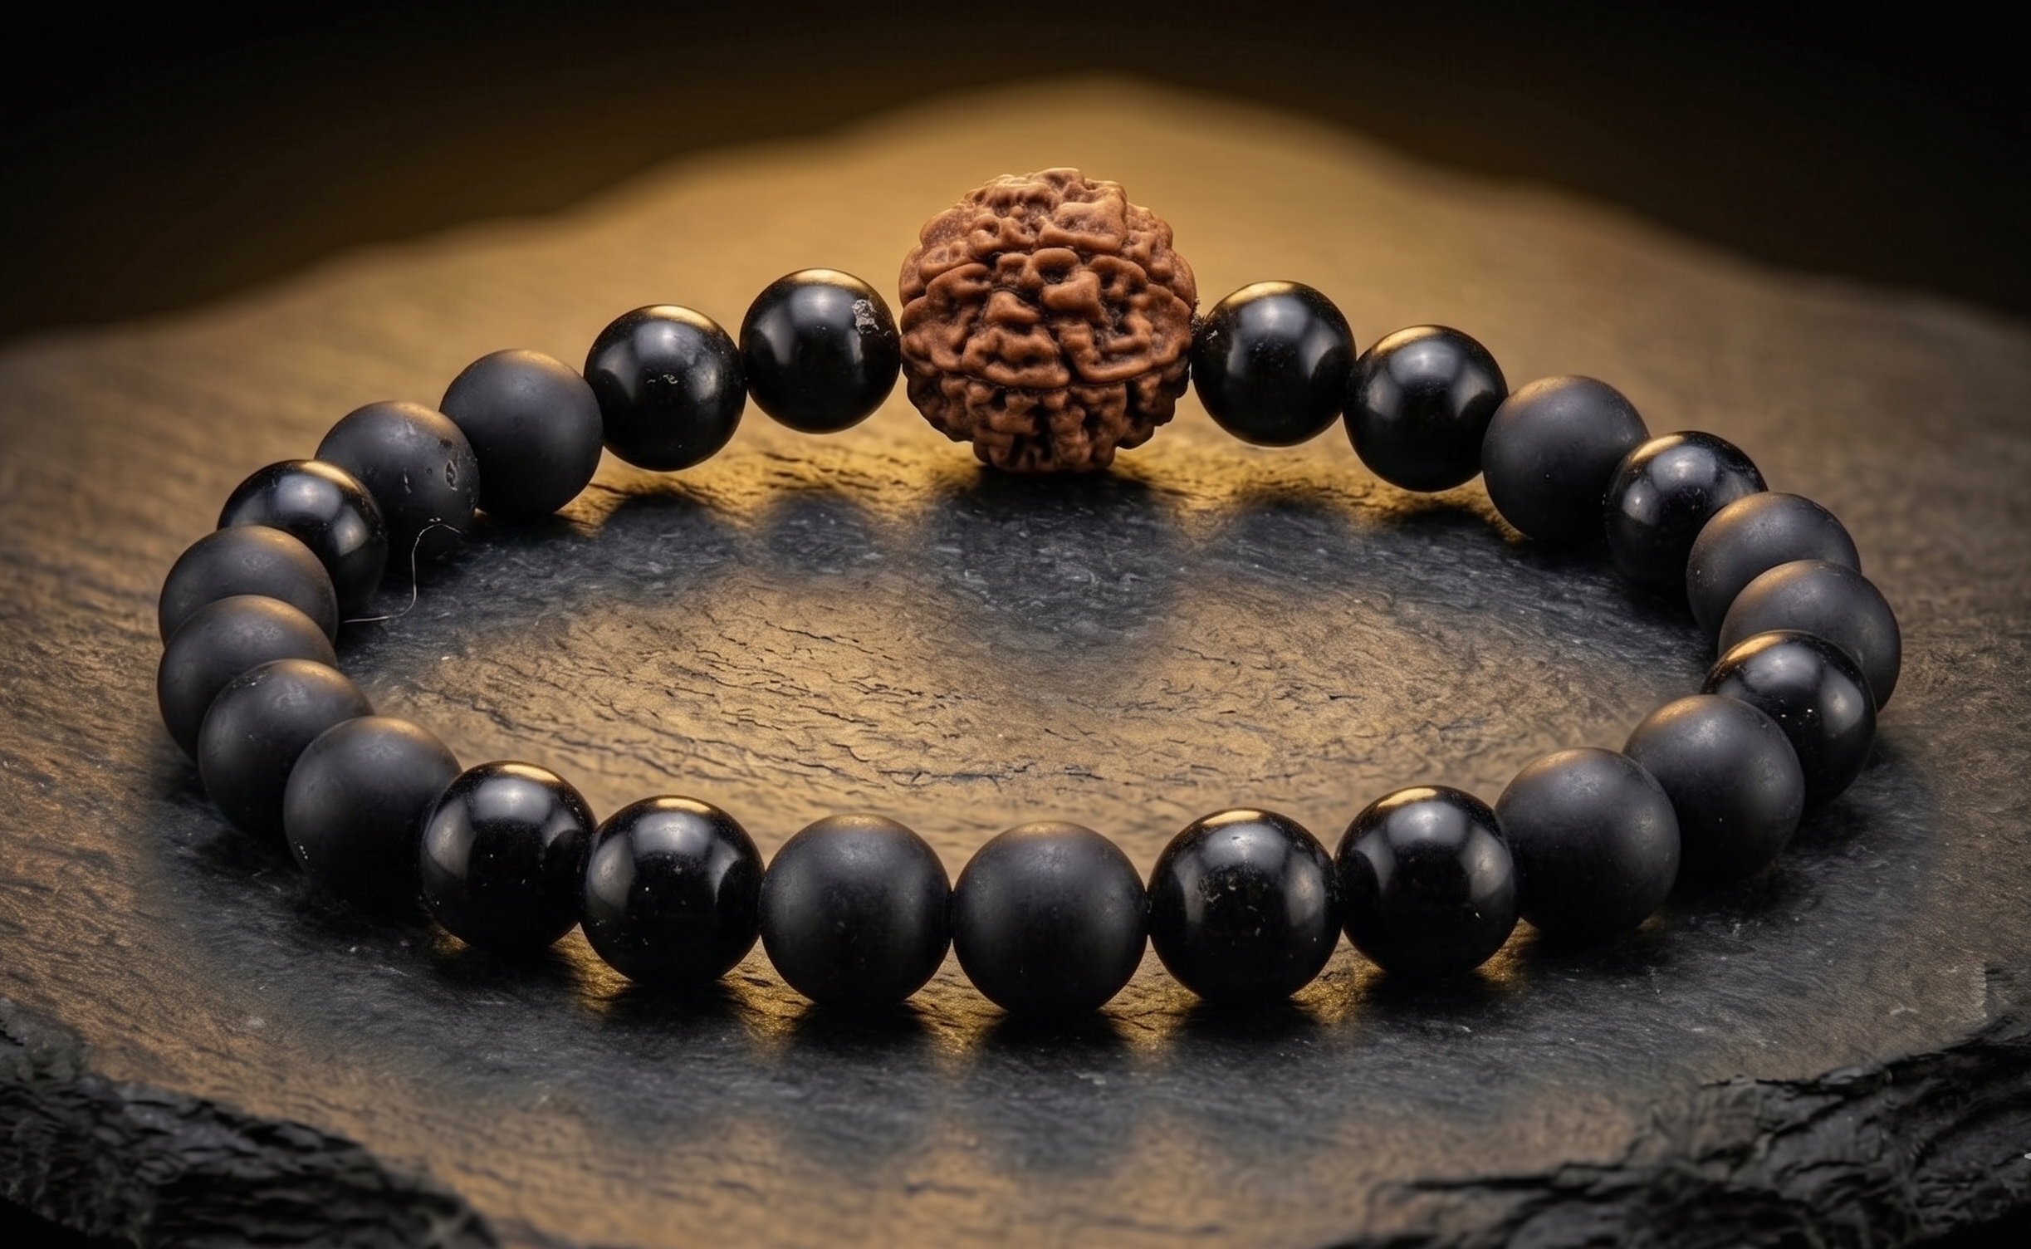
PRODUCT 03 OF 05
Rudra-Shila Raksha Mala
PERSONAL PROTECTION
रुद्र-शिला रक्षा माला
SPECIFICATIONS
Wrist mala: 26 polished 8mm shungite beads + 1 genuine Mukhi Rudraksha = 27 beads (sacred Vedic number). Elastic cord, unisex. Entry-level product — affordable, wearable, giftable. Volume seller.
Bead Size
8 mm polished
Count
27 (26 shungite + 1 Rudraksha)
Wrist Size
16 – 20 cm stretch
Weight
15 – 20 grams
"The shield of Rudra meets the oldest mineral on Earth. 27 beads, 27 nakshatras."
WHOLESALE
SUGGESTED MRP
RETAILER MARGIN
₹900 (25+ pcs)
₹1,499
40.0%

Slide 6
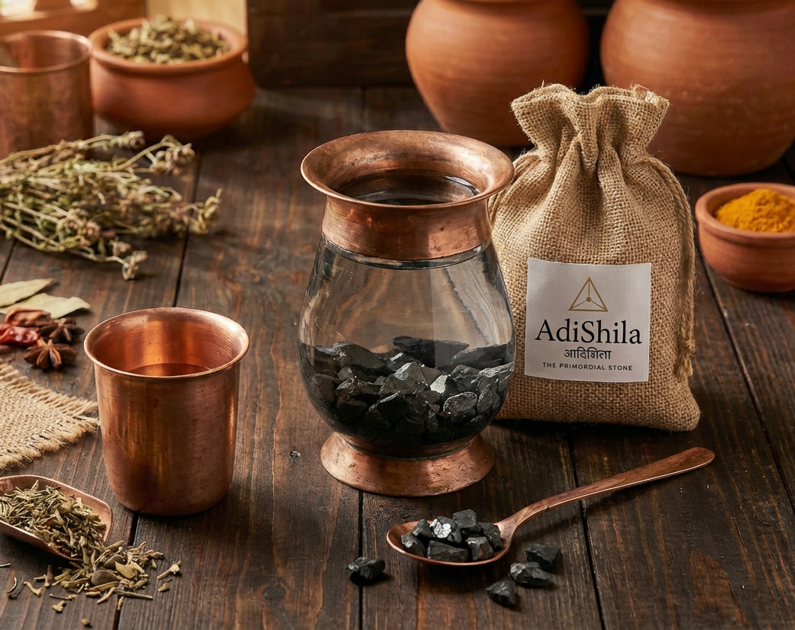
PRODUCT 04 OF 05
Amrit Jal Shuddhi Set
AYURVEDA WELLNESS
अमृत जल शुद्धि
Water purification ritual set: 300g washed shungite chips in a cotton/jute drawstring pouch with a copper coin. Designed for 3 litres (100g per litre). Shungite absorbs impurities; copper ionises water per Ayurvedic Tamra Jal tradition. Drop into any vessel, soak 6–8 hours.
SPECIFICATIONS
Shungite
300g washed chips (for 3 L)
Pouch
Cotton/jute drawstring
Copper
1 coin/disc insert
Lifespan
6 – 12 months
"Ayurvedic copper water meets the purifying power of a 2-billion-year-old mineral."
WHOLESALE
SUGGESTED MRP
RETAILER MARGIN
₹950 (25+ sets)
₹1,999
52.5%

Slide 7

PRODUCT 05 OF 05
Shila Raksha Pendant — OM
JEWELLERY
शिला रक्षा पेंडेंट — ॐ
Polished shungite disc pendant (25–30mm) with laser-engraved OM in gold paint. Waxed cotton cord (~50cm, adjustable). Worn at Vishuddha (throat) chakra for continuous EMF shielding. Unisex, daily wear.
SPECIFICATIONS
Diameter
30 – 35 mm
Thickness
5 – 6 mm
Weight
8 – 12 grams
Cord
Waxed cotton, adjustable
"An ancient stone at your heart. The eternal vibration of OM — every day, everywhere."
WHOLESALE
SUGGESTED MRP
RETAILER MARGIN
₹700 (25+ pcs)
₹1,299
46.1%

Slide 8
COMPLETE LINEUP
5 Products, 5 Categories
# | Product | Category | Wholesale | MRP | Margin
01 | Kavach Shield OM | EMF Protection | ₹800 | ₹1,499 | 46.6%
02 | Vastu Dosh Pyramid | Vastu Shastra | ₹1,100 | ₹2,199 | 50.0%
03 | Rudra-Shila Raksha Mala | Personal Protection | ₹900 | ₹1,499 | 40.0%
04 | Amrit Jal Shuddhi Set | Ayurveda Wellness | ₹950 | ₹1,999 | 52.5%
05 | Shila Raksha Pendant OM | Jewellery | ₹700 | ₹1,299 | 46.1%
WS prices exclusive of GST 18%. MOQ 25 pcs/SKU first order, 10 pcs reorders. Margin calculated on MRP (pre-GST).

Slide 9
PARTNERSHIP
Wholesale Terms & Conditions
MINIMUM ORDER
PAYMENT
25 pcs per SKU (first order)
10 pcs per SKU (reorders)
Samples: ₹500/SKU + shipping (refundable)
First order: 50% advance, 50% on dispatch
Reorders: 50% advance, 50% on dispatch
Bank transfer / UPI / Razorpay
DELIVERY
RETURNS & BREAKAGE
Pan-India shipping: 5–7 business days
Free shipping on orders above ₹25,000
Insured against transit damage
Broken items replaced free with photo proof within 48 hours.
Natural colour/texture variations are authentic features.
MARKETING SUPPORT
CUSTOMS & IMPORT
High-res product images provided
Social media creatives
Printed info cards with each product
QR authenticity verification
HS 6815.99 · GST 18% extra on WS
Example: ₹800 + ₹144 GST = ₹944 landed
Customs duties included in WS · GST invoices

Slide 10
Start Stocking AdiShila
Request samples, place a wholesale order,
or discuss exclusive territory partnerships.
REQUEST SAMPLES
Email: info@adishila.in
AdiShila · आदिशिला · The Primordial Stone

